Slide 1
Investing in real estate in Helsinki
By Jari Kuisma

Slide 2
Choosing where to invest is critical
The population of Helsinki is rapidly rising in the next few years.
In 2018 the population of Helsinki was 650 000.
In 2025 population will already be 700 000.
By 2050 population will be over 800 000.
This alone makes Helsinki a great city to invest in.

Slide 3
Choosing where to invest is critical
After deciding to invest in Helsinki, the next question is in which neighborhood should I invest?
Downtown Helsinki is the most expensive place to live in Finland. Are there any alternatives?

Slide 4
The data
This report uses data neighborhood price data provided by government-operated Statistics Finland
The data is updated quarter-yearly, so the dataset used for this report is of Q2/2019.
Foursquare API is used to find out what the neighborhoods are like in Helsinki.
Neighborhoods will be grouped based on these characteristics.
OpenStreetMap data is used to map Helsinki and its neighborhoods.
Nominatim is used as the search engine to find the coordinates of the neighborhoods.

Slide 5
methodology
The aim of this study was to find alternatives to downtown Helsinki.
Out of 75 neighborhoods, I identified neighborhoods that are similar to downtown, yet are more reasonably priced.
This narrowed the number of neighborhoods to 35.

Slide 6
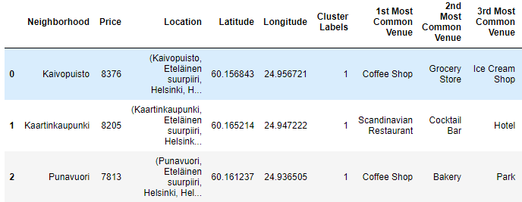
Characteristics of downtown helsinki
These characteristics can be described as “Social”:
Coffee shops
Restaurants
Parks
Etc.

Slide 7
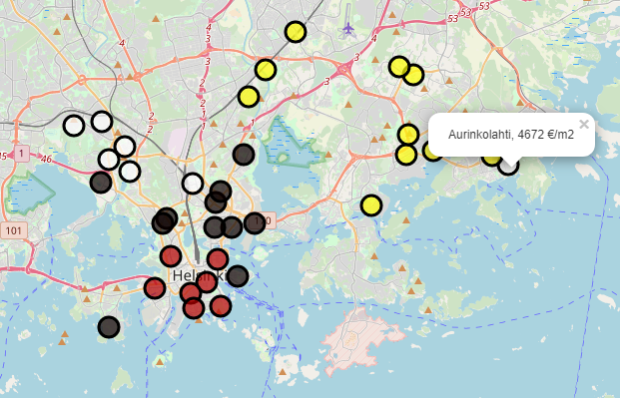
The results

Slide 8
The results
The neighborhoods were assigned to different colors based on their price.
The red neighborhoods cost: 7286 – 8376 €/m².
The black ones are 5580 – 6823 €/m².
The whites are 4407 – 5170 €/m².
Finally, the yellow ones are 2324 – 3569 €/m².

Slide 9
The most interesting outliers - katajanokka
Proximity to downtown Helsinki seems to be a great indicator of the price of a neighborhood.
Seven of eight “red” neighborhoods are downtown.
The only “black” neighborhood is Katajanokka. Katajanokka costs only 6215 €/m². The second cheapest neighborhood downtown costs 1000+ €/m² more, so Katajanokka would be on the top of my list of neighborhoods to target.

Slide 10
The most interesting outliers - itä-pasila
Another one to consider is Itä-Pasila. It is the southernmost “white” neighborhood on the map, located very near more expensive neighborhoods.
Itä-Pasila is about 500 €/m² cheaper than its nearest neighbors.
Additionally, one of the biggest malls in Finland is opening in Pasila in October 2019. The effect of this is clearly not yet seen in the prices of apartments in Itä-Pasila.

Slide 11
conclusion
The study identified two potential neighborhoods to target:
Katajanokka (6215 €/m²)
Itä-Pasila (5015 €/m²)
Both are located near more expensive neighborhoods, and there really is no justification why these two neighborhoods are cheaper.
I expect these two neighborhoods to gain more value in the coming years than any other neighborhood in Helsinki.

